Slide 1

Module PROJECT:- data visualization
INTERACTIVE DASHBOARD DEVELOPEMANT of BASIC Financial analysis for exploratory data analysis (EDA)

Slide 2
GROUP MEMBERS
TAIMOR HASSAN ROLL NO (107)
MUHAMMAD QASIM ROLL NO (232)
SECTION (II)

Slide 3
OBJECTIVE:-
The objectives of a dashboard of basic financial analysis for Exploratory Data Analysis (EDA):The primary objective of a financial analysis dashboard is to provide an overview of financial performance, identify trends and patterns, and support data-driven decision-making. Specifically, the dashboard aims to analyze revenue, expenses, profitability, and cash flow, tracking key performance indicators (KPIs) such as ROI, ROE, and debt-to-equity ratio. The dashboard should include visualizations (bar charts, line charts, pie charts), metrics (financial ratios, growth rates), and filters (time period, product/service, region) to facilitate interactive exploration. Targeting financial analysts, business owners, managers, and investors, the dashboard seeks to improve financial insights, enhance business strategy, increase efficiency, and better manage risk.

Slide 4
ABOUT DATASET
Basic financial analysis .
In this dataset Total numbers of rows is [3265].
Total numbers of columns \ features is [14].
Region(Asia, UK, USA) , Country, Sales Reps, First Name Last Name,
Gender, Age, Rank levels, Store, Products, Years, Quarter, Month, Revenue(USD)
REFERENCE
GitHub

Slide 5
PREPROCESSING
Reprocessing financial data is a crucial step that involves cleaning, transforming, and preparing data for analysis. This process begins with handling missing values through imputation or interpolation, followed by removing duplicates and outliers to ensure data consistency. Data types are then converted as necessary, such as date and currency formats, and normalized or scaled using techniques like log transformation to prevent feature dominance. Categorical variables, like sector and industry, are encoded to facilitate analysis. Noisy or irrelevant data is removed, and data is aggregated from quarterly to annual, if required. Additionally, currency fluctuations and inflation are addressed to maintain accuracy. Finally, thorough data quality checks are performed to ensure consistency and accuracy, enabling reliable financial analysis and informed decision-making.
REFERENCE
Rapid miner

Slide 6
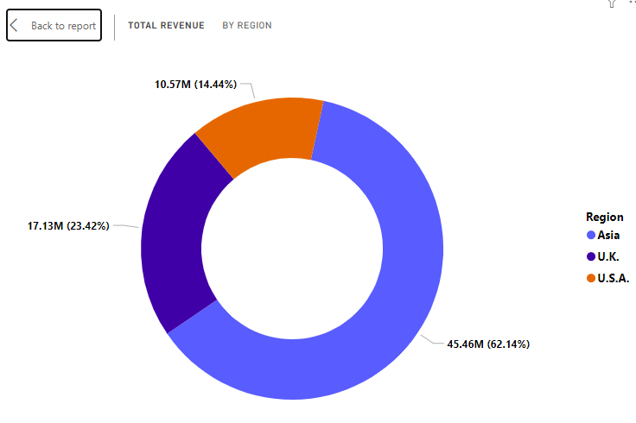
DASHBOARD making for (EDA) by using power-bi total revenue by region:-
Reasons of choosing Donut Chart:
Visualize part-to-whole relationship: Donut charts effectively show how each region contributes to the total revenue.
2. Proportional comparison: Donut charts facilitate comparison of revenue proportions across regions.
3. Easy to read: Donut charts are visually appealing and easy to understand, even for non-technical stakeholders.

Slide 7
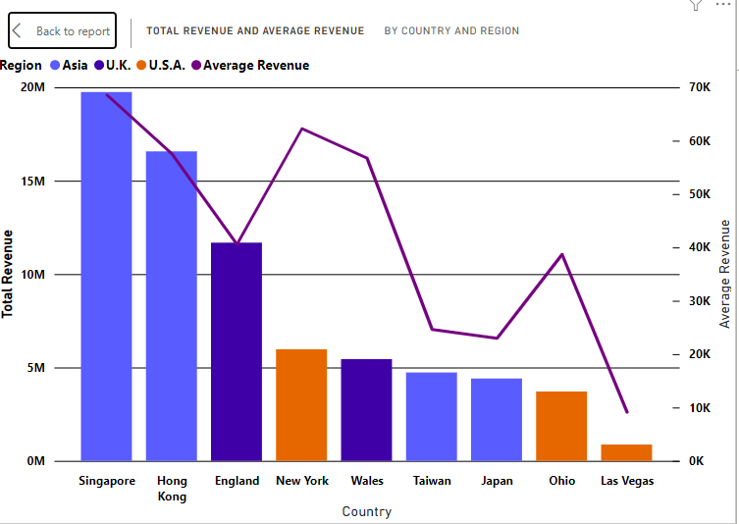
Total REVENUE AND AVERAGE REVENUE BY COUNTRY AND REGION
Reason of choosing Line and stacked Colum chart
Line Chart:
1. Trends and patterns: Line charts effectively show revenue trends over time.
2. Comparing regions: Lines facilitate comparison of revenue growth across regions.
Stacked Column Chart:
1. Total and component values: Stacked columns display total revenue and regional contributions.
2. Categorical comparison: Columns facilitate comparison of revenue across regions.

Slide 8
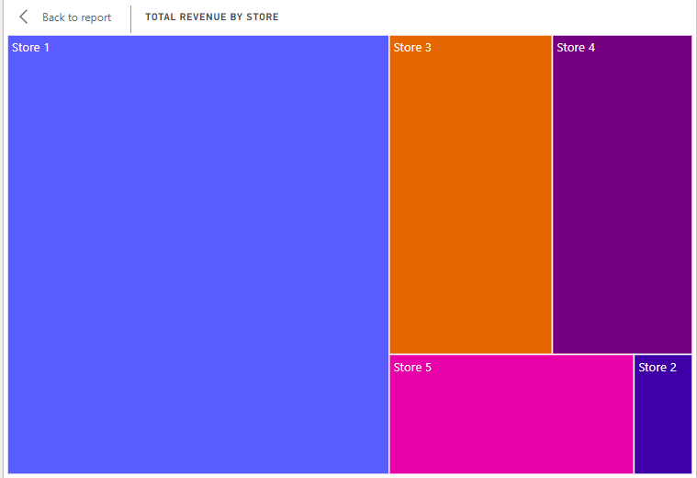
TOTAL REVENUE BY Store
Reasons of choosing a Tree map:
1. Visualizing large datasets: Tree maps efficiently display multiple stores and metrics.
2. Space-efficient: Utilizes space effectively, avoiding clutter.
3. Proportional comparison: Size and color encode revenue and other metrics.

Slide 9
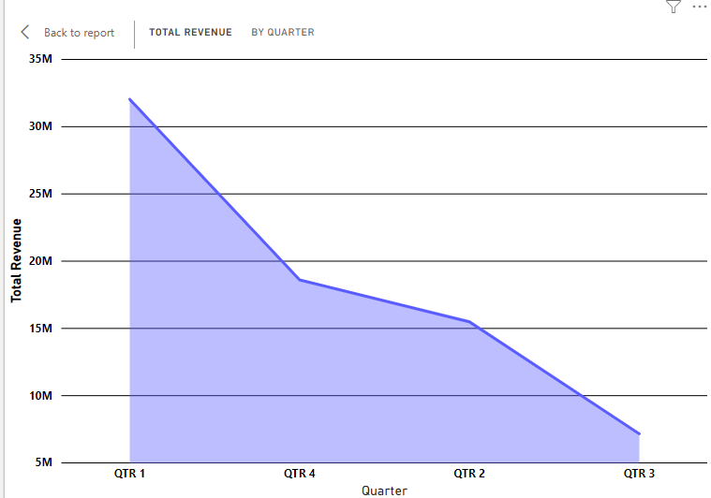
Total REVENUE BY QUARTER
Reasons of choosing Area chart:
1. Effective for showing trends and patterns
2. Cumulative totals visualization3. Overlapping areas for period comparison
4. Seasonal analysis capabilities

Slide 10
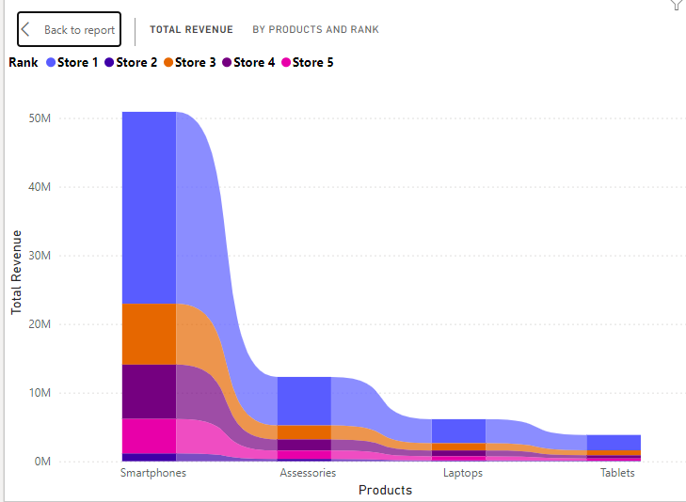
TOTAL REVENUE BY PRODUCTS AND Rank
Reasons of choosing Ribbon chart:
Effective for displaying ranked data
Visualizes revenue fluctuations
Highlights top-performing products
Facilitates product comparison5. Dynamic visualization

Slide 11
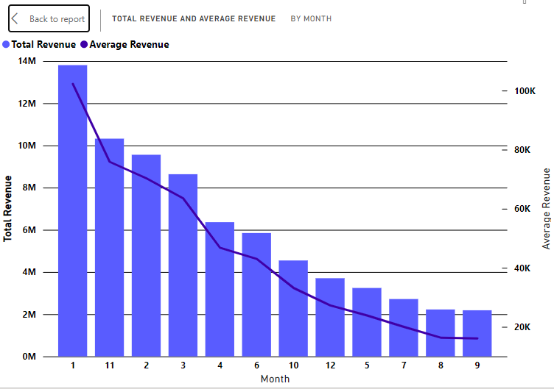
Total revenue and average by month
Reason of choosing Line and stacked Colum chart
Line Chart:
1. Trends and patterns: Line charts effectively show revenue trends over time.
2. Comparing regions: Lines facilitate comparison of revenue growth across regions.
Stacked Column Chart:
1. Total and component values: Stacked columns display total revenue and regional contributions.
2. Categorical comparison: Columns facilitate comparison of revenue across regions.

Slide 12
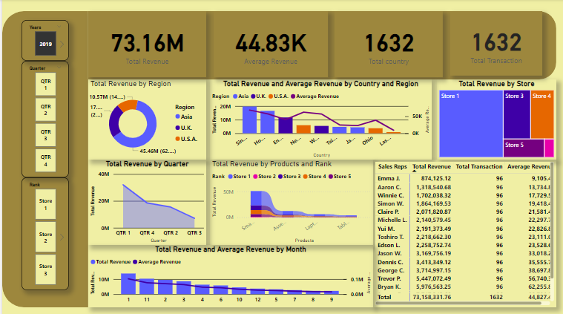
OVER ALL DASHBOARD

Slide 13
WHY WE CREATED a DASHBOARD
Creating a dashboard is crucial for effective data analysis and decision-making. The primary objectives of a dashboard include visualizing complex data, streamlining decision-making, improving data-driven insights, enhancing collaboration, and monitoring performance metrics. By achieving these objectives, a dashboard provides numerous benefits, such as real-time data visibility, increased productivity, data-driven decision-making, improved communication, and identifying trends and patterns.

Slide 14
WHY WE perform (EDA)
Primary Objectives:
1. Understand data distribution and patterns.
2. Identify data quality issues.3. Discover relationships between variables.4. Inform hypothesis generation.
5. Guide model selection and development.
Key Benefits:
1. Improved data understanding.
2. Identification of potential biases.
3. Detection of outliers and anomalies.
4. Insight into correlations and relationships.
5. Enhanced model accuracy.

Slide 15
STORE of overall project
We started with data acquiration involves collecting data from various sources such as databases, APIs, files, and surveys. Next, data preprocessing cleans and transforms the data by handling missing values, removing duplicates and outliers, transforming data types, encoding categorical variables, and splitting data into training and testing sets. Following preprocessing, data transformation reshapes and aggregates data for analysis. Then, Exploratory Data Analysis (EDA) begins with data visualization to understand distributions, correlations, and patterns, using techniques like histograms, scatter plots, and heat maps. EDA also involves statistical summary calculations, such as mean, median, and standard deviation, and data quality checks for inconsistencies and anomalies. Finally, feature engineering extracts relevant features from the data, and dimensionality reduction techniques like PCA or t-SNE simplify complex data for modeling, completing the preparation of data for modeling and machine learning.

Slide 16

Happy Learning!

